Slide 1

Aftercare.

Slide 2

Do We Really
Offer Aftercare?
Notes:
"It’s easy to say we offer aftercare. But if we’re honest — does every family feel it? Do we offer it consistently, or only sometimes? Would every family say they felt supported weeks and months after the funeral? That’s the standard we must hold ourselves to."
70% of consumers say connected processes — where they don’t have to repeat themselves — are very important to winning their business. (Salesforce, 2023)

Slide 3
Do We Really
Offer Aftercare?
Ask Yourself:
When does our care truly end?
Is our aftercare consistent or occasional?
Would every family say they felt supported?
Notes:
Before we dive in, I want to start with some honest reflection. We all care deeply about the families we serve, but when it comes to aftercare, it’s worth asking: Is our follow-up structured? Is it something every family can count on? Or is it dependent on the day, the workload, or who happens to be there?
For many, aftercare is a heartfelt intention, but not always a consistent experience.
And that’s where some of the biggest gaps in family support happen. Today’s conversation is about seeing those gaps... and thinking differently about how we fill them.

Slide 4




Your Journey Forward
Training & Development
Equip your team to deliver every
touchpoint with heart and excellence
Implementation Support
Step-by-step support to integrate
the program into daily service
A structured, compassionate means to stay connected after the service.
Curated Materials:
Thoughtfully designed to support
families and funeral homes

Slide 5

Notes:
Every piece in the kit is intentional. Whether it’s grief support, estate settlement help, or a soft introduction to planning ahead — everything is designed to meet real needs families face immediately after a loss.
We’re not throwing them into a sales funnel. We’re building a bridge.

Slide 6



What Families Receive
Grief Support
Practical Resources
Preplanning Introduction
Notes:
We’re not throwing them into a sales funnel. We’re building a bridge.
This simple, repeatable 4-step process helps families feel cared for--- and opens the door for future conversations naturally.

Slide 7
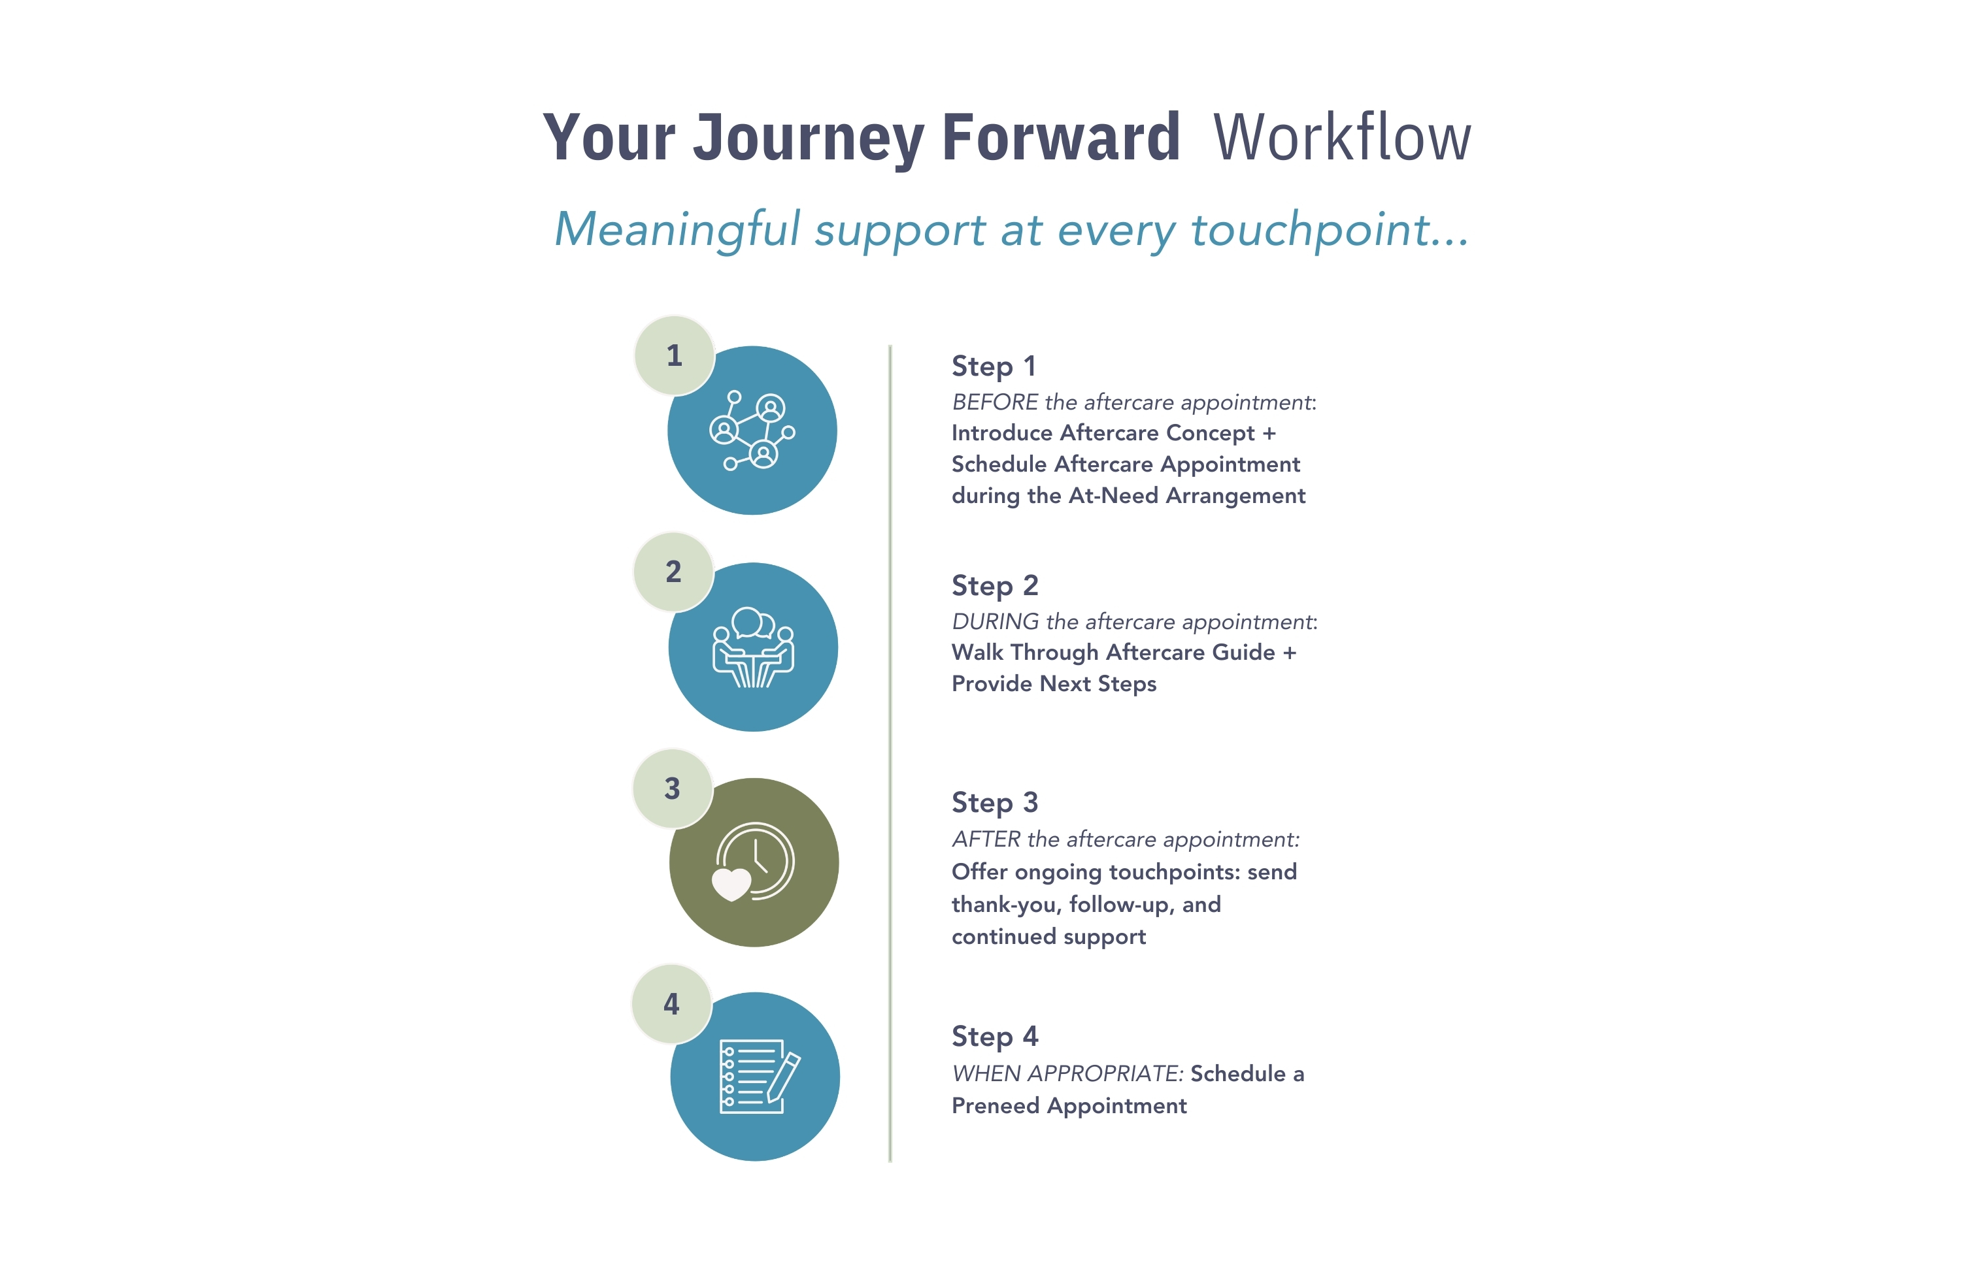
Your Journey Forward Workflow
Step 1
Introduce Aftercare Concept +
Schedule Aftercare Appointment during the At-Need Arrangement
Arrangement Conference
Aftercare Appointment
Step 2
Walk Through Aftercare Guide + Provide Next Steps
Ongoing
Support
Step 3
Offer ongoing touchpoints: thank-you, follow-up, and continued support
Preplanning
Conversations
Step 4
When appropriate, schedule a Preneed Appointment
Notes:
Now that you’ve seen the big picture workflow, let’s break it down.
What exactly happens at each stage? What do families experience? What tools are introduced? I’m going to walk you through the real steps — from the arrangement conference all the way through future planning conversations — so you can see how it all fits together in a natural, compassionate way
This simple, repeatable 4-step process helps families feel cared for — and opens the door for future conversations naturally.

Slide 8

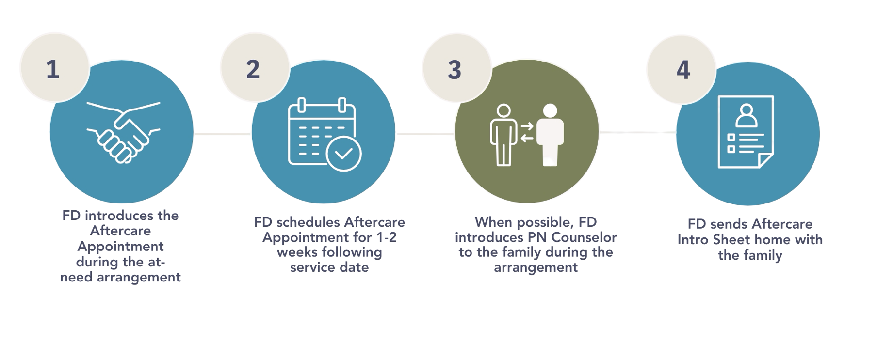
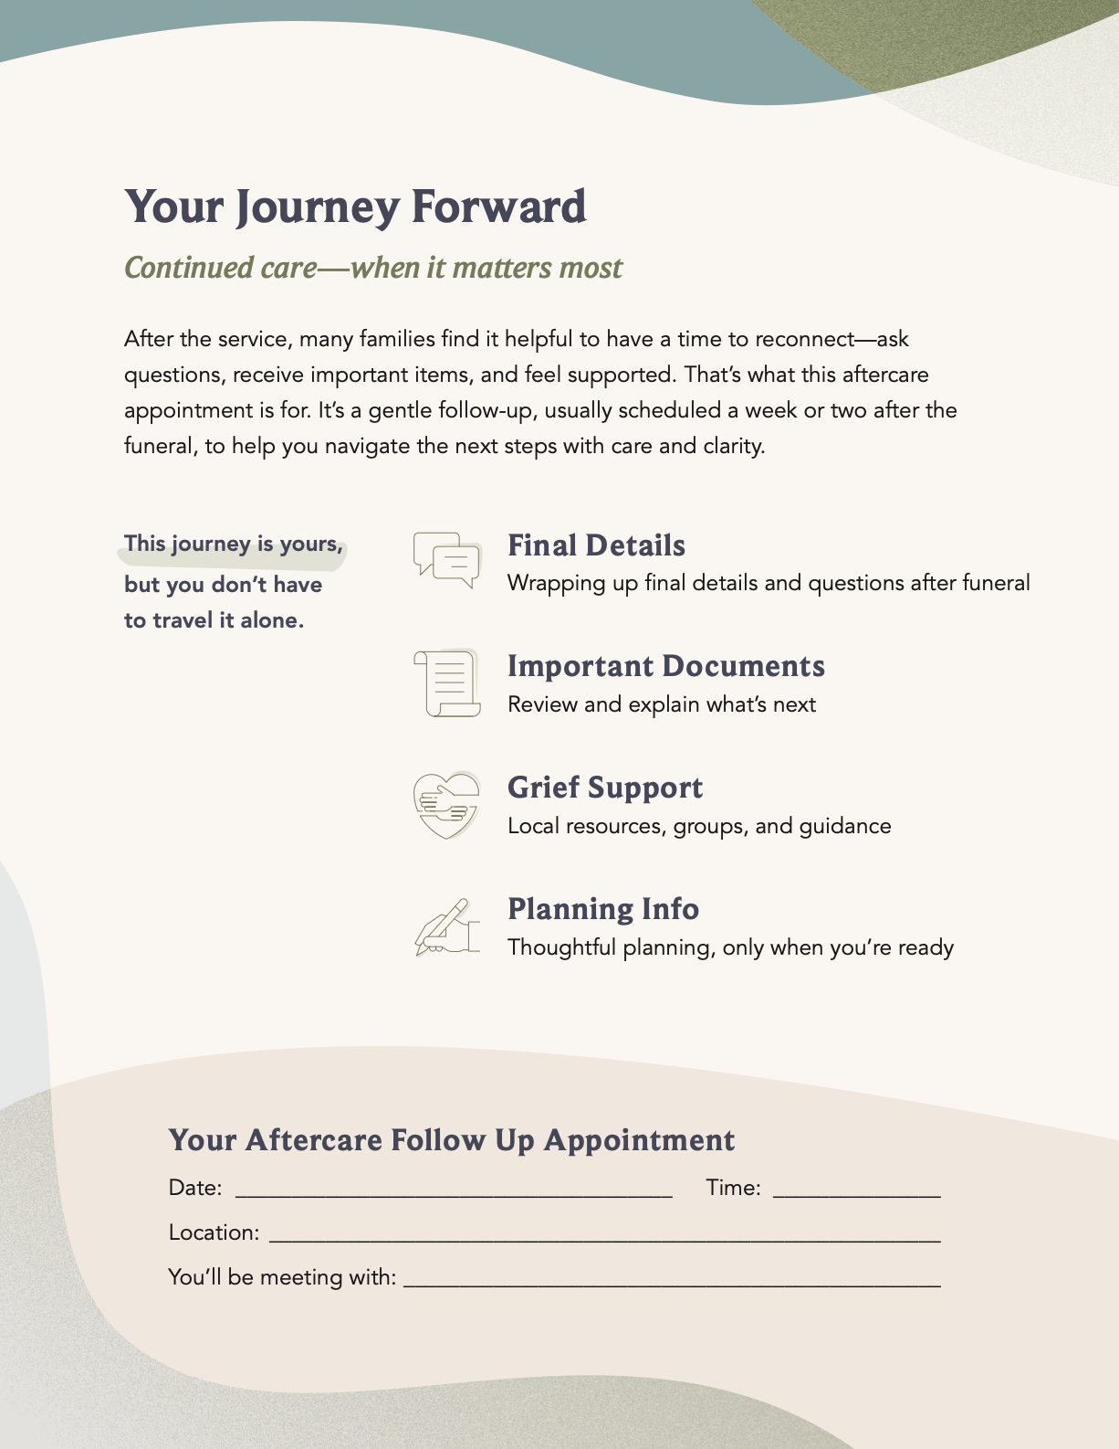
At-Need Arrangement Conference
Step 1
SETTING THE STAGE:

Slide 9
The Aftercare Appointment
Step 2
Goals:
Connect with family
Share resources
Gently introduce preplanning

Slide 10
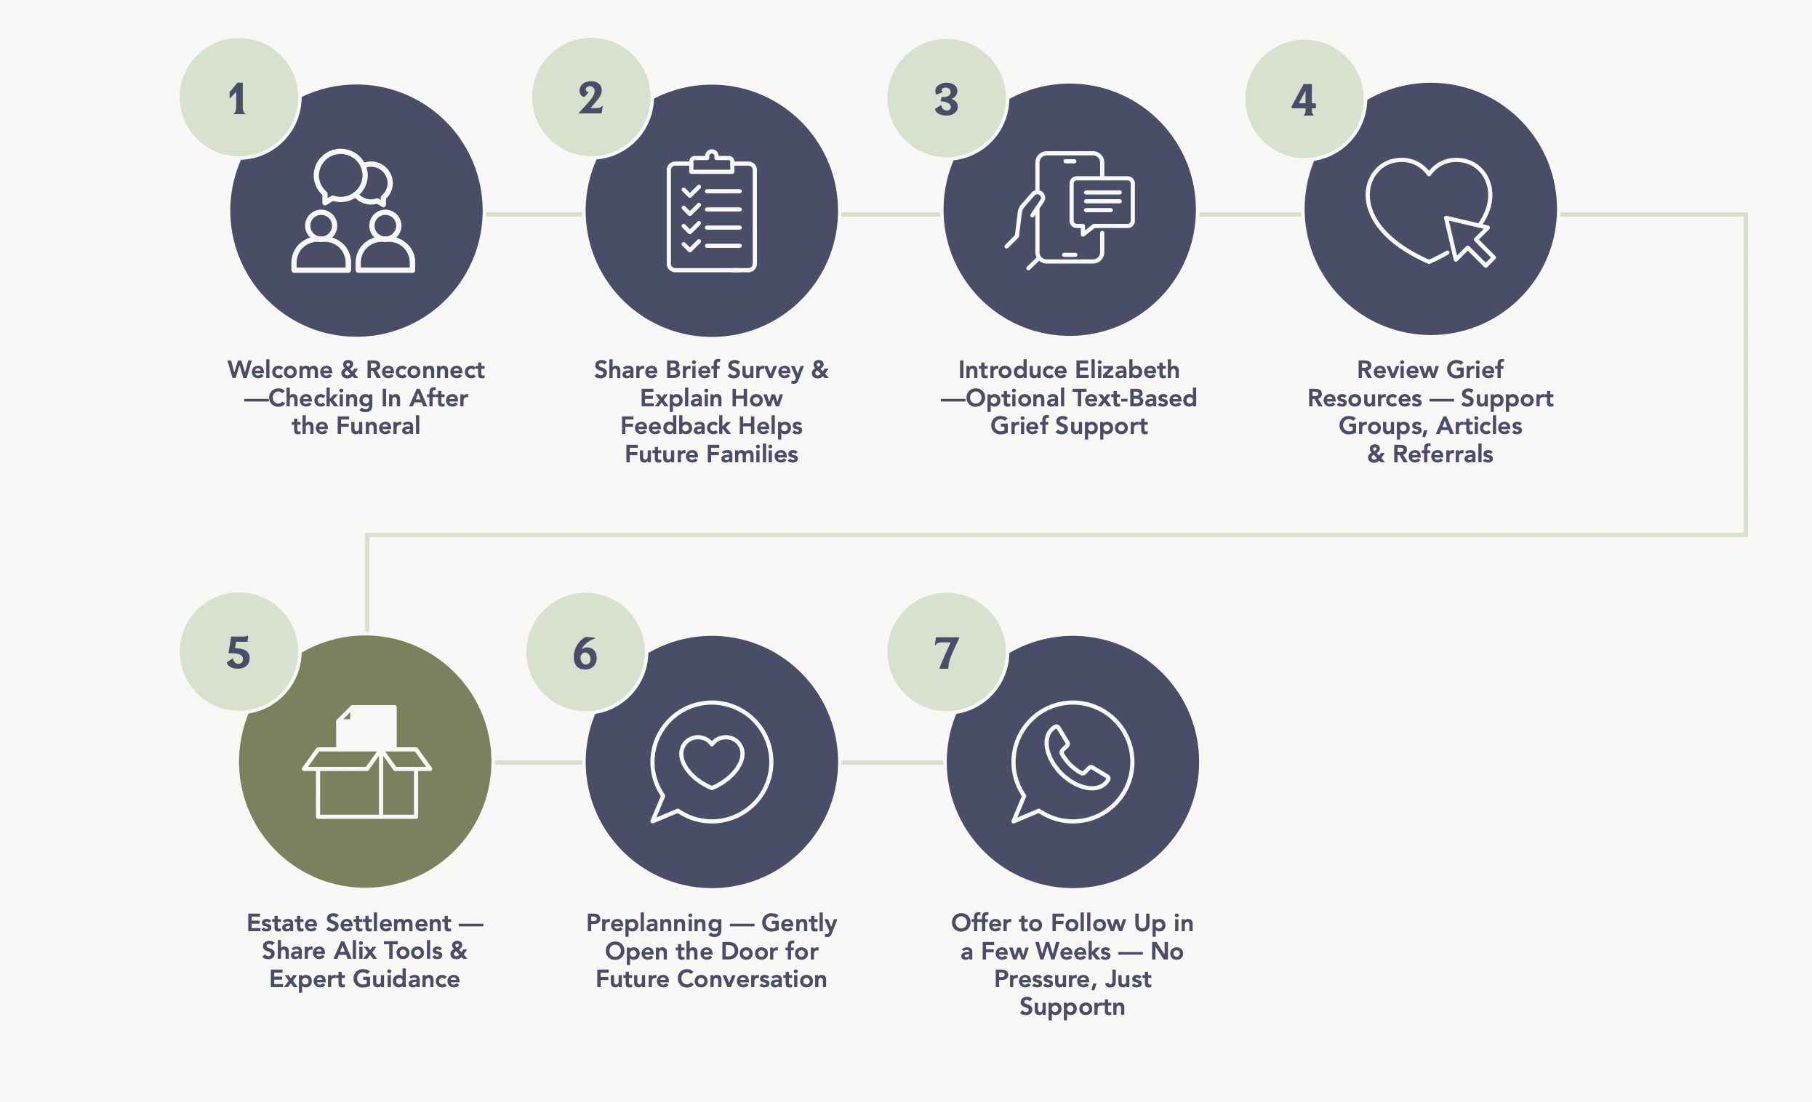
The Aftercare Appointment

Slide 11



Connecting with the family
Listen more
than you talk.
Engage with
the heart.
Make a conversation.
Not a checklist.
Emotional Connection Matters:
306% higher lifetime value (Motista)
+70% of buying decisions based on feelings (McKinsey)
81% won’t buy without a trust client/advisor relationship (Edelman)
Notes:
"This appointment is sacred space. A time to reconnect. To ask, listen and support. It’s not about a checklist. It’s about the heart. And data shows it matters — 81% of consumers won’t buy from someone they don’t trust. This is where that trust grows."

Slide 12
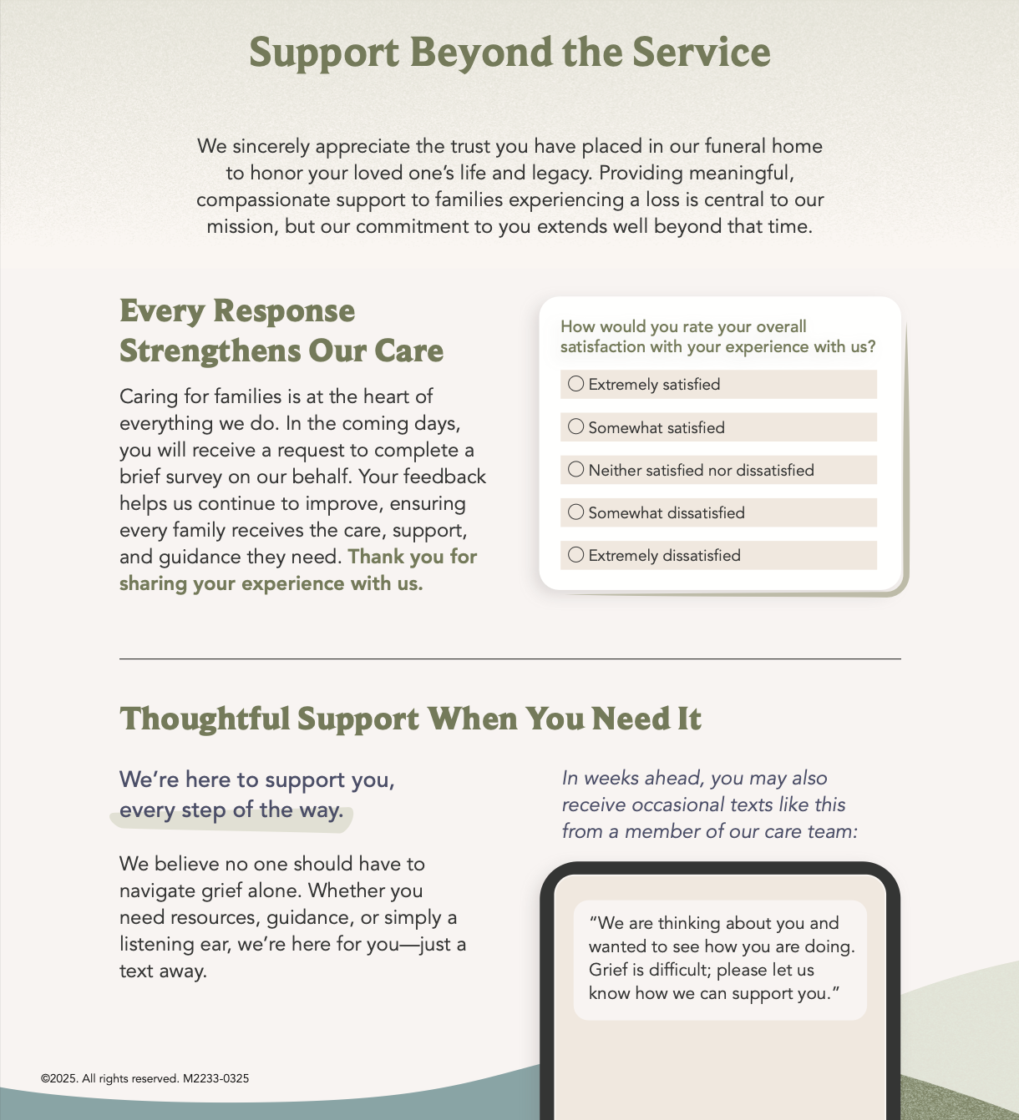
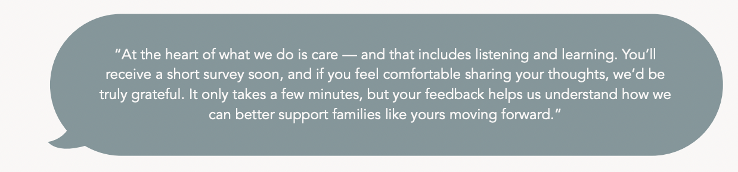
Survey Introduction
Families will receive a survey by text or email.
Highlight simplicity - a few questions about their experience.
Invite personally: “Your voice helps us improve.”

Slide 13
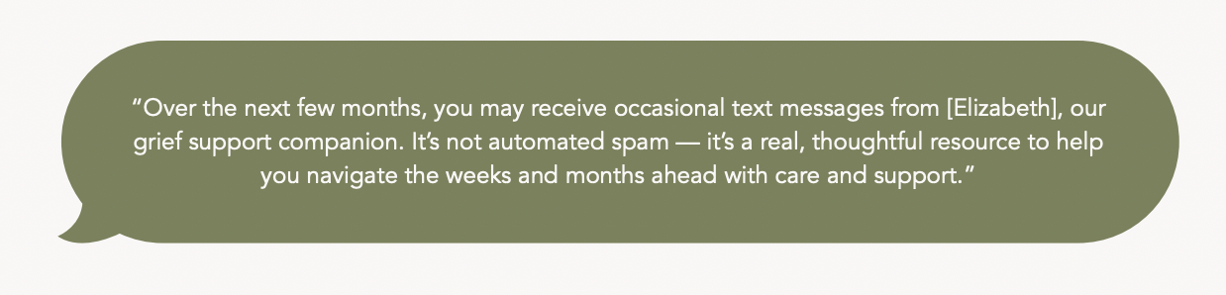
Elevia Text-Based Aftercare
Key Points:
Introduce Elizabeth as part of our aftercare team offering gentle check-ins.
Graciously ensure them it’s not spam, but they can always opt out if they choose.
Notes:
"Aftercare is about listening. The Elevia survey is a soft check-in, and our text-based platform ensures families know we’re still with them. It’s personal, not pushy — and they can always opt out. But most don’t. Because it feels human."

Slide 14
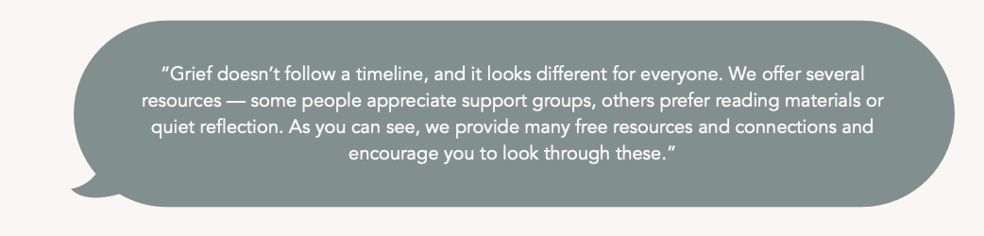
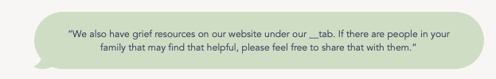
For Grief Introduction
Key Points:
Free, on-demand grief support anytime.
Guides, videos, book lists, and community.
Part of how we extend our care and support beyond today.

Slide 15
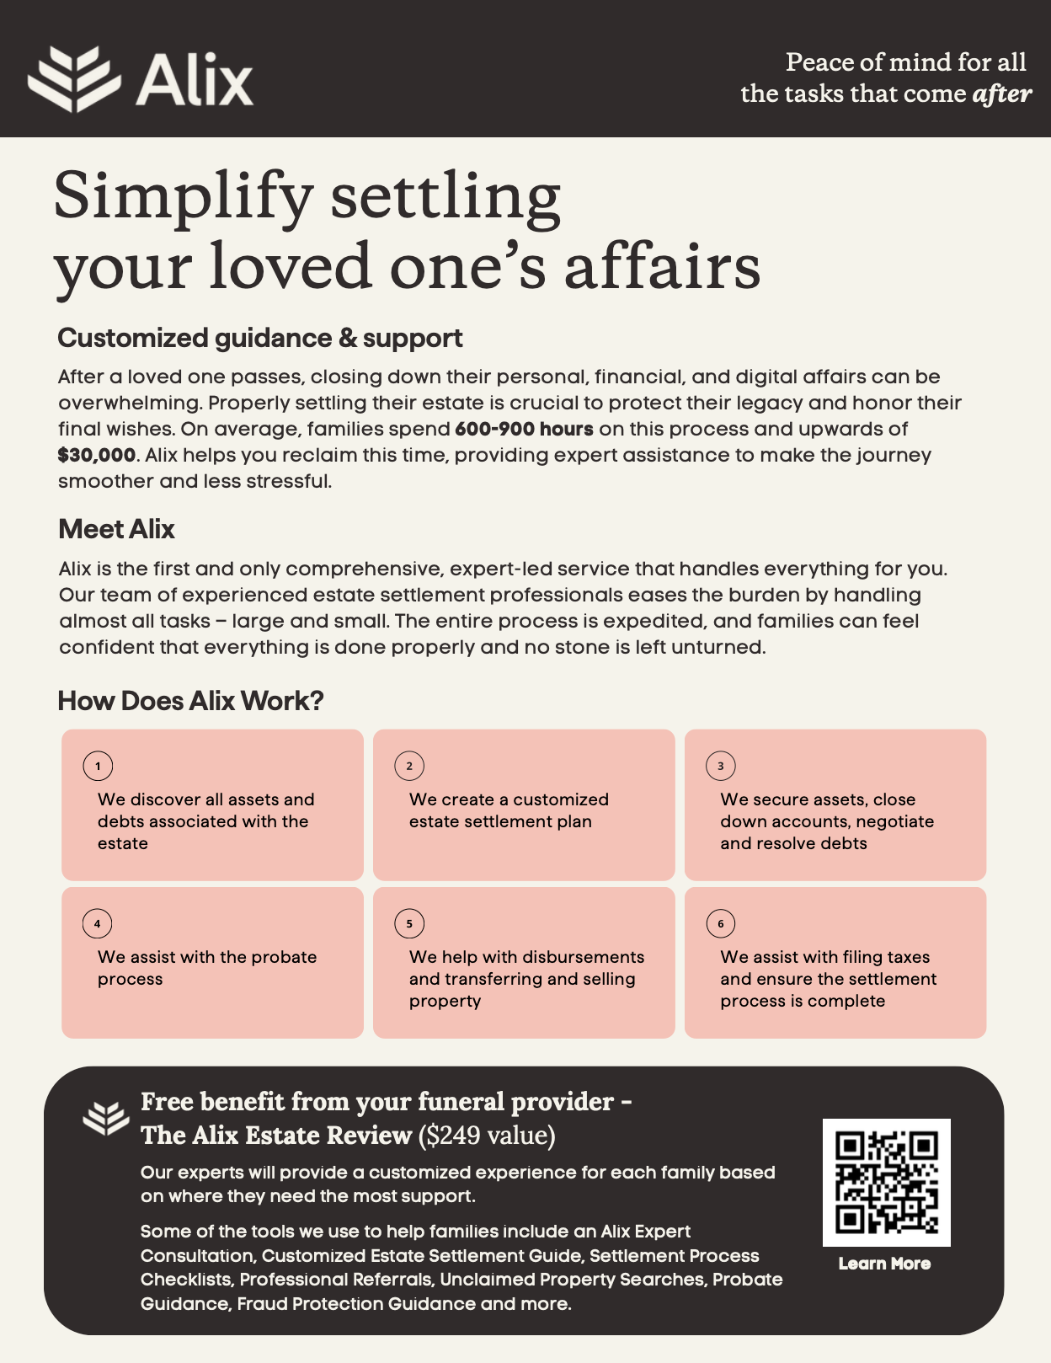
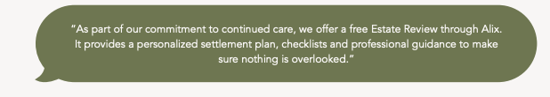
Estate Settlement through Alix
Key Points:
Alix provides expert estate settlement assistance to help families navigate the legal and financial steps after a loss.
Families receive a free Alix Estate Review ($249 value) through the funeral provider, including a consultation, customized settlement guide, fraud protection guidance and assistance with assets, debts and probate.

Slide 16
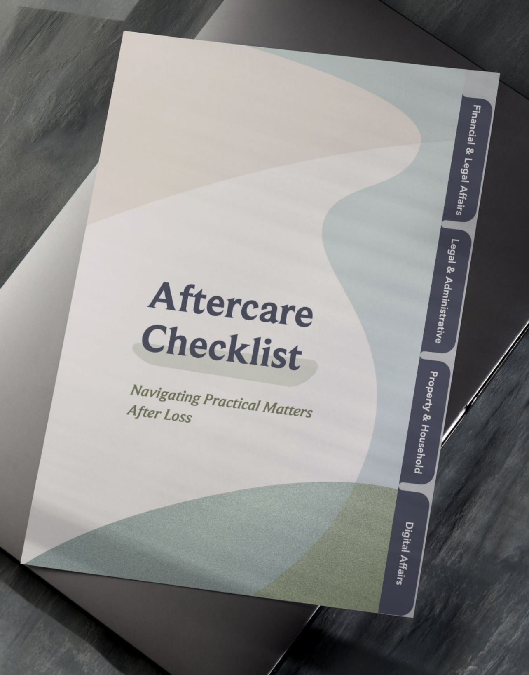
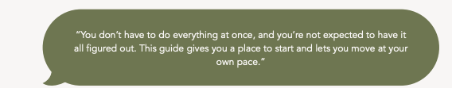
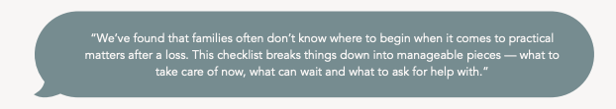
Practical Checklist
Key Points:
A compassionate guide to help families stay organized after a loss.
A supportive starting point — not every step will apply or need to be faced alone.

Slide 17

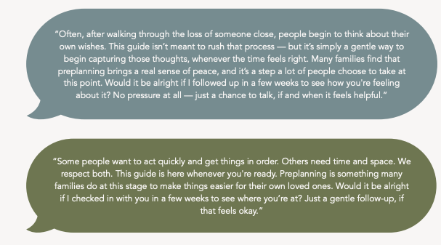
Preplanning Guide
Every person is on their own timeline.
It’s about setting the table for a future conversation.

Slide 18
Offering, not pushing…
Success found in:
Lead with care — Offer support, not urgency.
Normalize reflection — It’s natural to think about wishes after a loss.
Invite, don’t push — Offer to follow up without pressure.

Slide 19
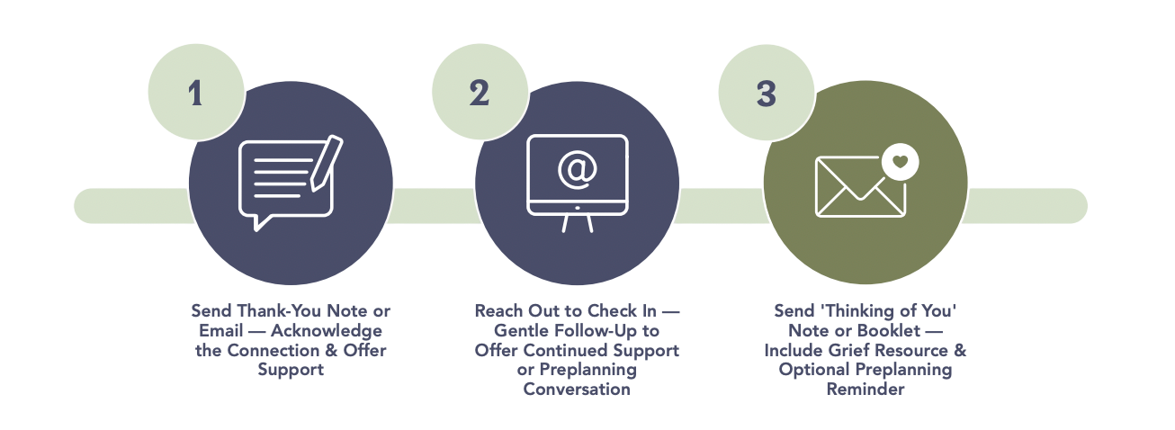
Ongoing Support
Step 3

Slide 20
Preplanning Appointment
Step 4
Goals:
Prioritize the family: Reconnect and meet them where they are.
Preserve Their Story: Gather personal details and wishes.
Personalize Their Preferences: Shape services that reflect their life and values.
Protect Their Plan: Fund the plan to ease future burdens.

Slide 21

Training + Implementation
Implementation Guide
Training & Development
Implementation Support
Equipping your team with the tools, training, and support to deliver exceptional care.

Slide 22

Implementation
Guide
Create a uniformed
approach through:
Scripting Cues
Best Practices
Workflows
Collateral Explanations

Slide 23

Live & Recorded Webinars
Slide Decks
Comprehensive training sessions covering implementation steps, common questions, and best practices
Recorded sessions for ongoing reference and staff onboarding
Concise and practical: Gives leaders and directors a high-level overview of the program and their role.
Tailored Messaging: In-depth for some, streamlined for others.

Slide 24

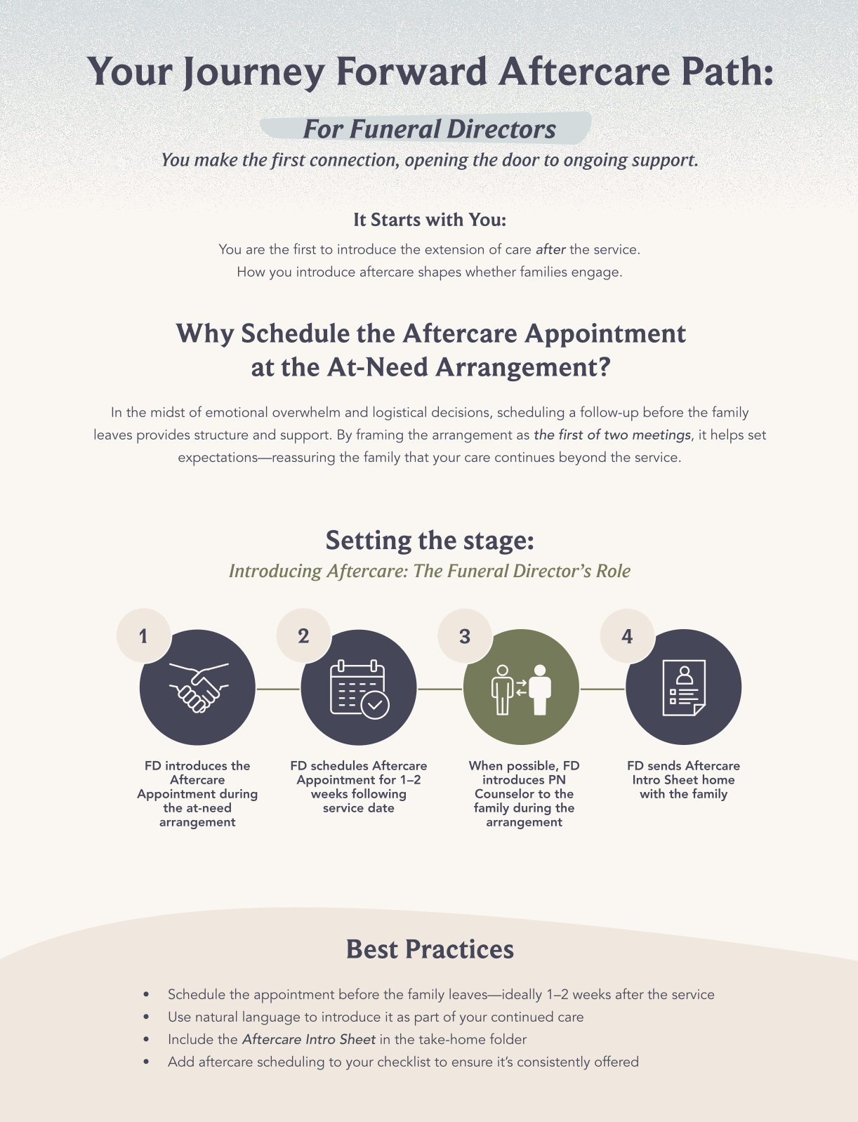
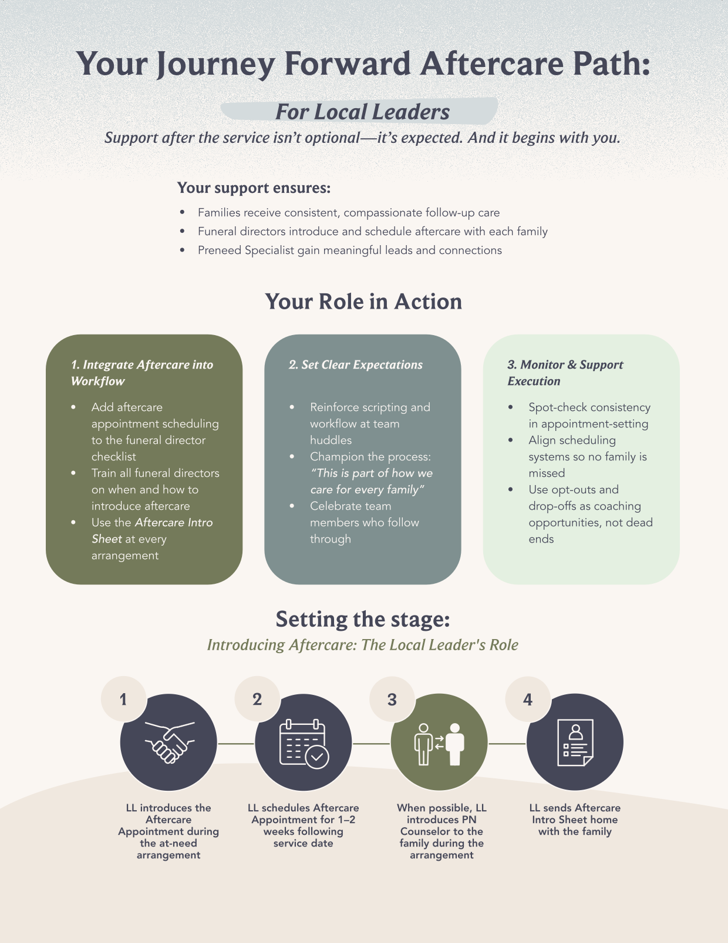
Stakeholder Buy In
Clear and focused: Tailored to show leaders and funeral directors the purpose, value, and their role.
Built for buy-in: Connects to the "why" and emphasizes impact without overwhelming detail.

Slide 25

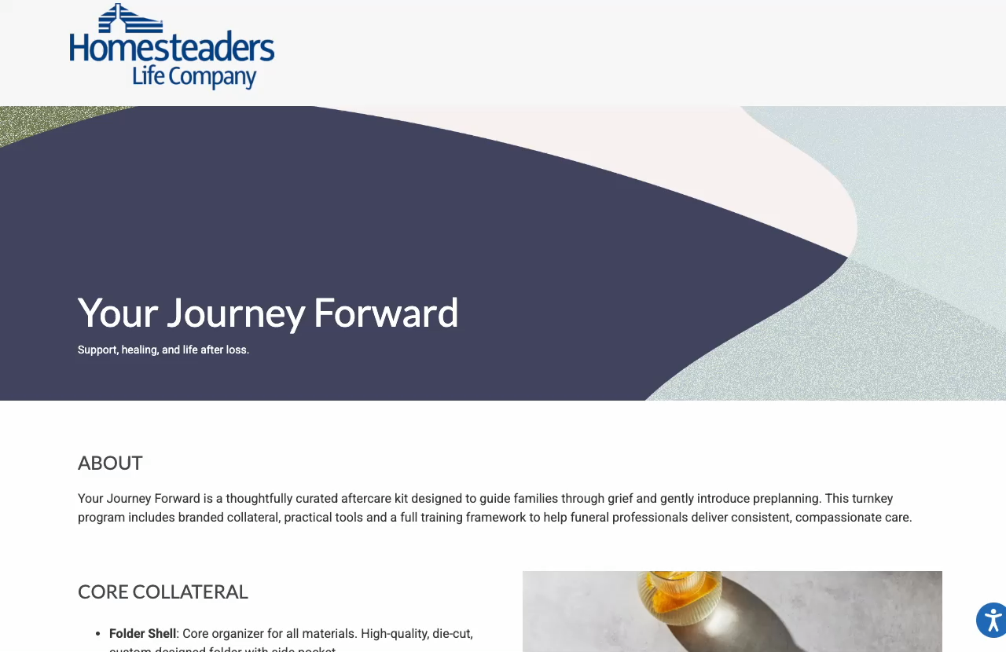
Centrally-Located
Resource Hub
Centralized site with training, materials and tools all in one place.
Password-protected but accessible to all staff you desire.
Available anytime for easy, ongoing support and reference.

Slide 26

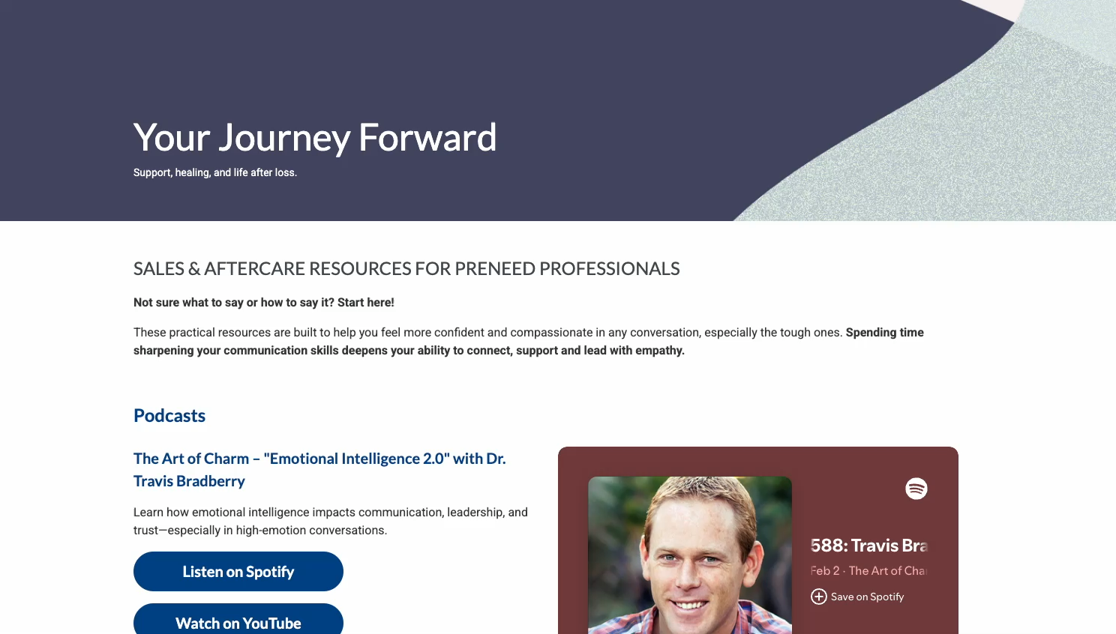
Learning Library
Practical tools to strengthen communication and connection in tough conversations.
Articles, videos, and podcasts focused on sales with empathy, especially when serving grieving families

Slide 27










Why Aftercare?
Families Need
Teams Need
Outcomes
Support
Structure
Greater Trust
Clarity
Confidence
Better Family Experience
Connection
Process
Long-Term Relationship

Slide 28
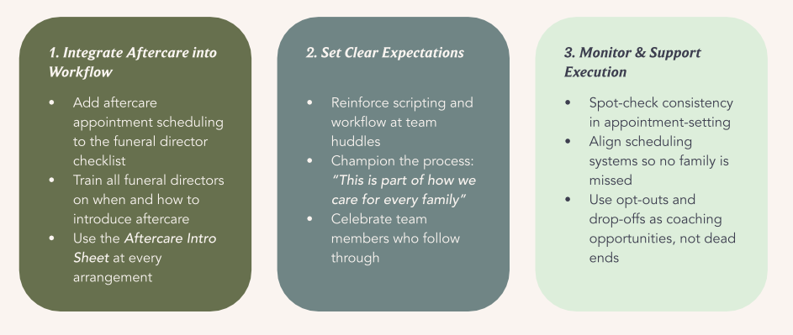
Best Practices For Success

Slide 29

Your Role
Educate
Implement
Inspire

Slide 30

Families never forget who stayed.
Notes:
"It's easy to be there when the room is full, when the ceremony is beautiful, when everyone’s watching.
But what matters most — what families never forget — is who stayed when the crowds were gone."

