Slide 1

Aftercare.

Slide 2

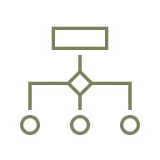


Your Journey Forward
Training & Development
Equip your team to deliver every
touchpoint with heart and excellence
Implementation Support
Step-by-step support to integrate
the program into daily service
A structured, compassionate means to stay connected after the service.
Curated Materials:
Thoughtfully designed to support
families and funeral homes

Slide 3

Notes:
Every piece in the kit is intentional. Whether it’s grief support, estate settlement help, or a soft introduction to planning ahead — everything is designed to meet real needs families face immediately after a loss.
We’re not throwing them into a sales funnel. We’re building a bridge.

Slide 4



What Families Receive
Grief Support
Practical Resources
Preplanning Introduction
Notes:
We’re not throwing them into a sales funnel. We’re building a bridge.
This simple, repeatable 4-step process helps families feel cared for — and opens the door for future conversations naturally.

Slide 5
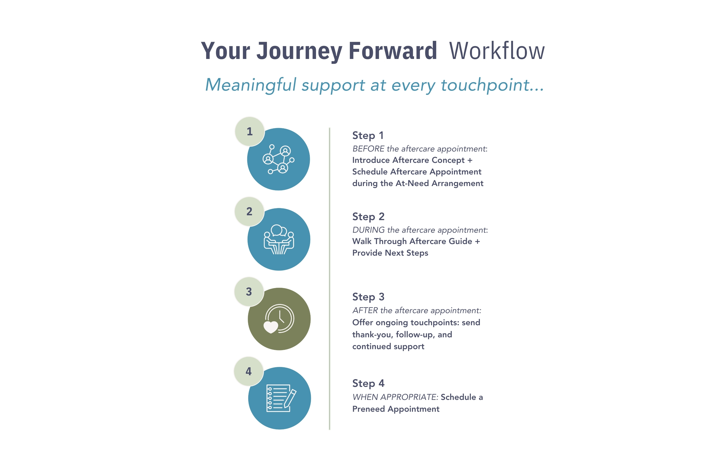
Your Journey Forward Workflow
Step 1
Introduce Aftercare Concept +
Schedule Aftercare Appointment during the At-Need Arrangement
Arrangement Conference
Aftercare Appointment
Step 2
Walk Through Aftercare Guide + Provide Next Steps
Ongoing
Support
Step 3
Offer ongoing touchpoints: thank-you, follow-up, and continued support
Preplanning
Conversations
Step 4
When appropriate, schedule a Preneed Appointment
Notes:
Now that you’ve seen the big picture workflow, let’s break it down.
What exactly happens at each stage? What do families experience? What tools are introduced? I’m going to walk you through the real steps — from the arrangement conference all the way through future planning conversations — so you can see how it all fits together in a natural, compassionate way
This simple, repeatable 4-step process helps families feel cared for — and opens the door for future conversations naturally.

Slide 6

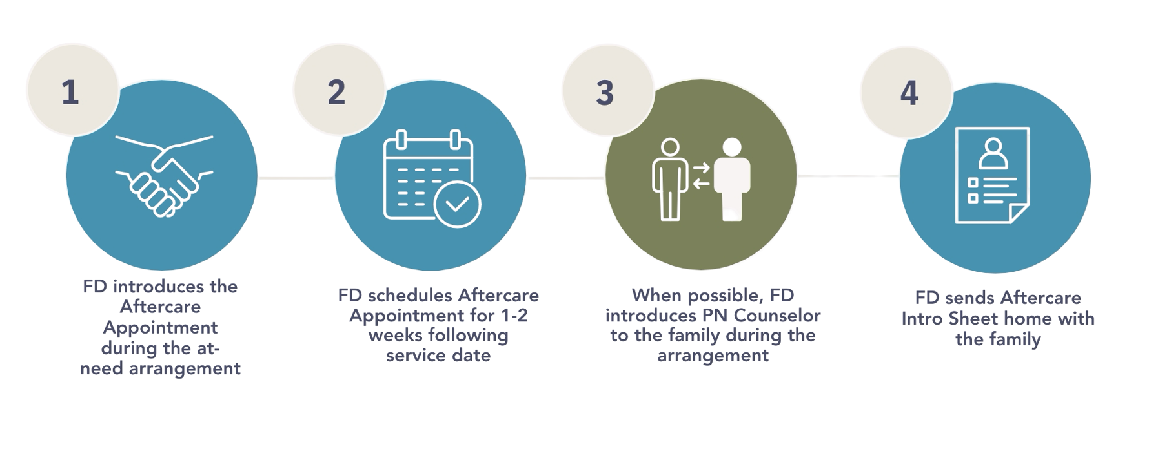
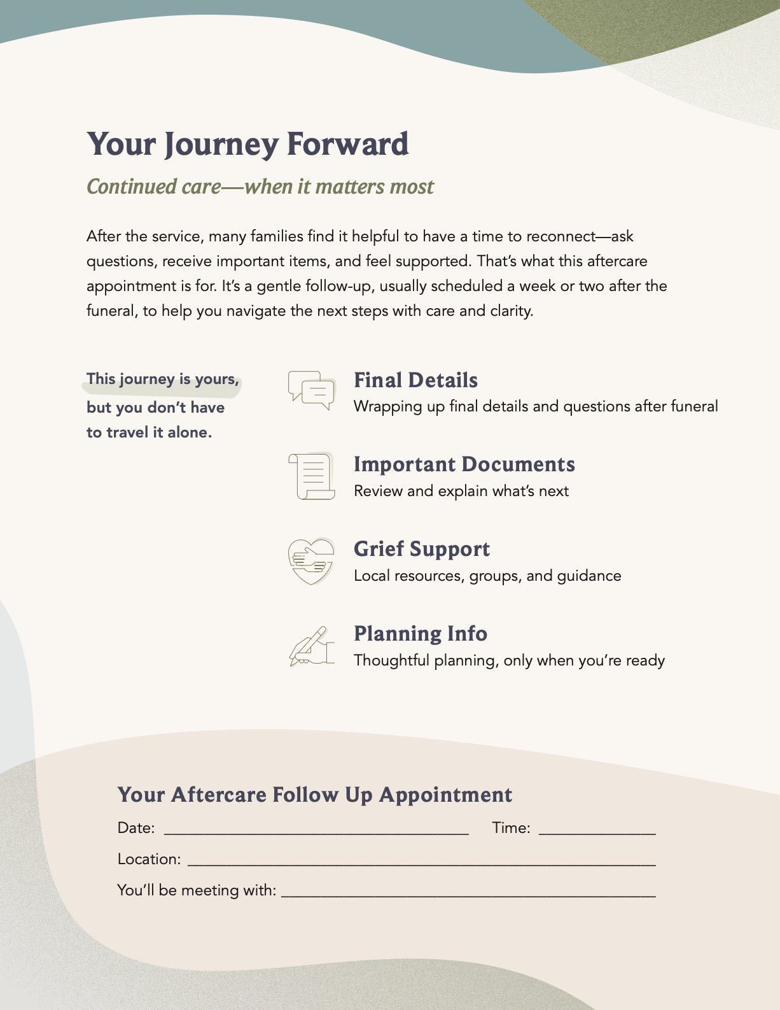
At-Need Arrangement Conference
Step 1
SETTING THE STAGE:

Slide 7
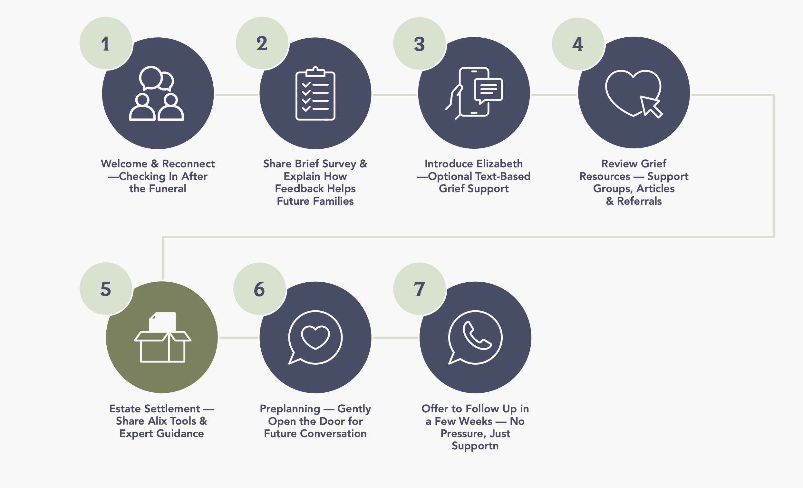
The Aftercare Appointment

Slide 8
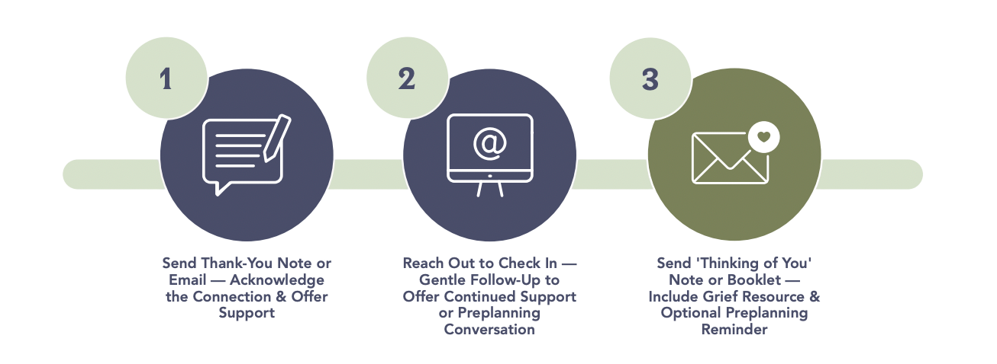
Ongoing Support
Step 3

Slide 9
Preplanning Appointment
Step 4
Goals:
Prioritize the family: Reconnect and meet them where they are.
Preserve Their Story: Gather personal details and wishes.
Personalize Their Preferences: Shape services that reflect their life and values.
Protect Their Plan: Fund the plan to ease future burdens.

Slide 10

Training + Implementation
Implementation Guide
Training & Development
Implementation Support
Equipping your team with the tools, training, and support to deliver exceptional care.

Slide 11

Implementation
Guide
Create a uniformed
approach through:
Scripting Cues
Best Practices
Workflows
Collateral Explanations

Slide 12

Live & Recorded Webinars
Slide Decks
Comprehensive training sessions covering implementation steps, common questions, and best practices
Recorded sessions for ongoing reference and staff onboarding
Concise and practical: Gives leaders and directors a high-level overview of the program and their role.
Tailored Messaging: In-depth for some, streamlined for others.

Slide 13

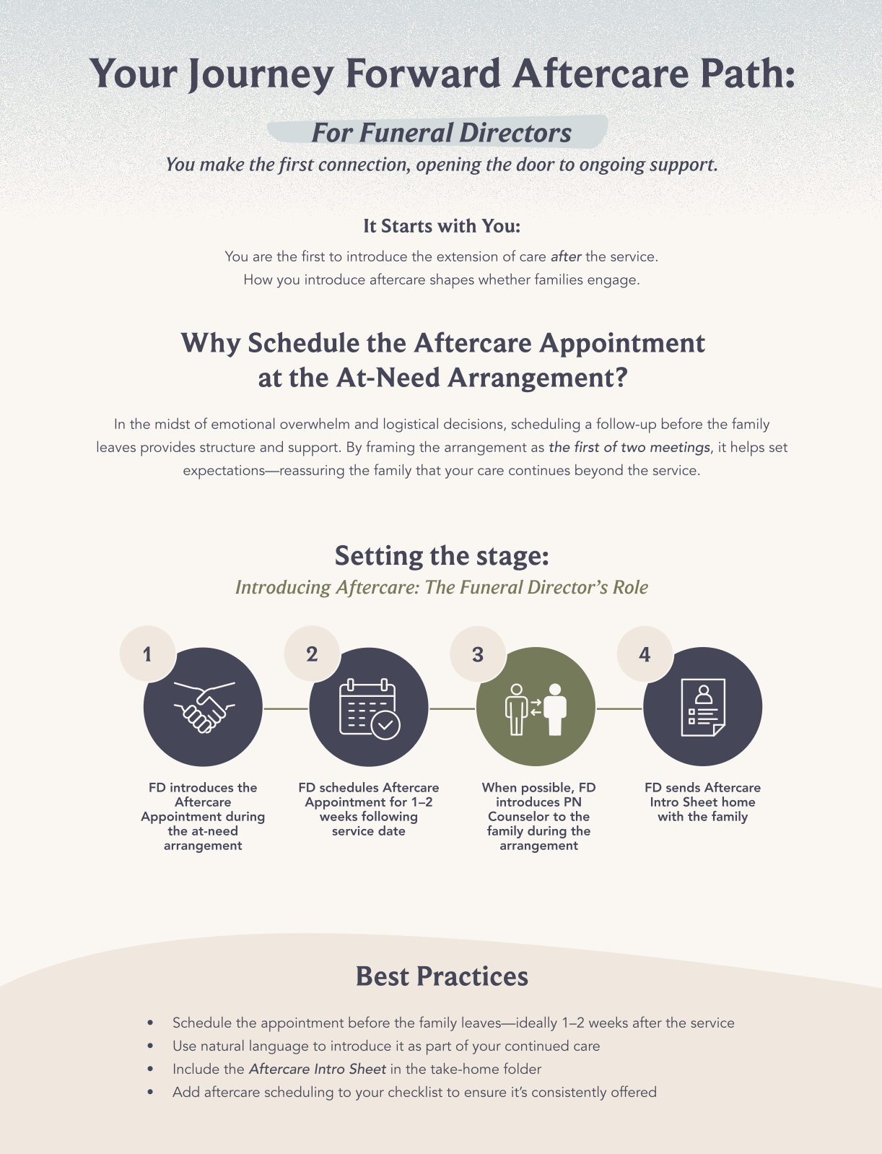
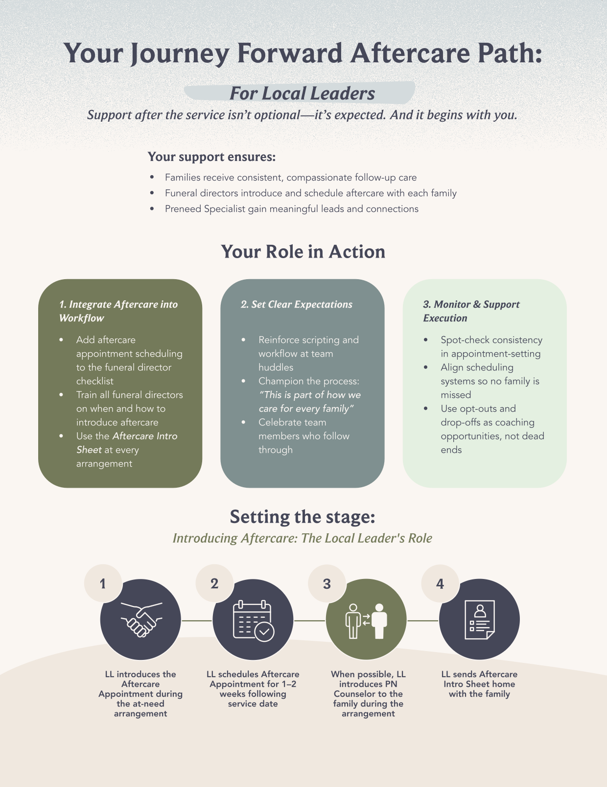
Stakeholder Buy In
Clear and focused: Tailored to show leaders and funeral directors the purpose, value, and their role.
Built for buy-in: Connects to the "why" and emphasizes impact without overwhelming detail.

Slide 14

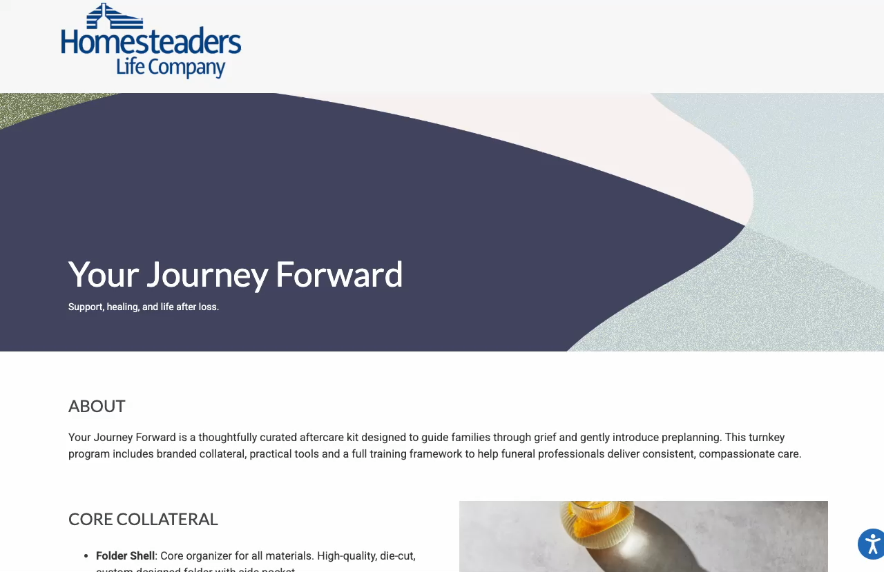
Centrally-Located
Resource Hub
Centralized site with training, materials and tools all in one place.
Password-protected but accessible to all staff you desire.
Available anytime for easy, ongoing support and reference.

Slide 15

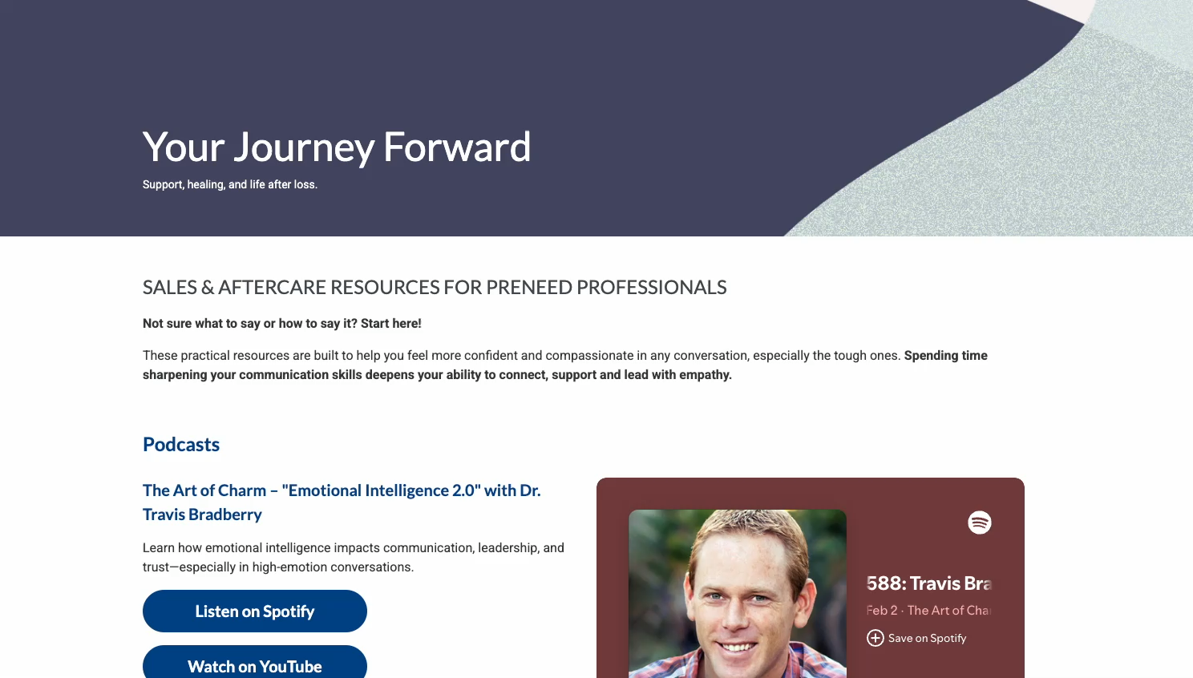
Learning Library
Practical tools to strengthen communication and connection in tough conversations.
Articles, videos, and podcasts focused on sales with empathy, especially when serving grieving families

Slide 16
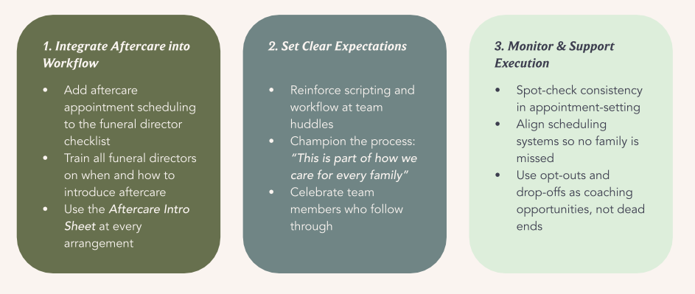
Best Practices For Success

Slide 17


Families never forget who stayed.
Notes:
"It's easy to be there when the room is full, when the ceremony is beautiful, when everyone’s watching.
But what matters most — what families never forget — is who stayed when the crowds were gone."

